Slide 1

Annexure B
2022/23 Financial Year Mid-Year Budget and Performance Assessment
BY CHIEF FINANCIAL OFFICER

Slide 2
  Institutional Health
Key Focus Areas of the Mid-Year Engagement
  Session 1
  Current institutional arrangement to sustain financial integrity & governance, spatial transformation and drive service delivery
  Progress with implementation of institutional reforms i.e. mSCOA, Circular 88, Economic Recovery, SNDB, `CIDMS, Programme and Project Preparation
  Planning, budget and reporting alignment
Financial Health
  Session 2:
  Financial performance for the 2020/21 financial year
  2021/22 Mid-year performance
  2021/22 Adjustment Budget Estimate Proposal
  2022/23 Budget preparation
Governance
  Session 3
  Auditor General’s findings as reported for the 2020/21 financial year
  Consequence management and or Special Adjustment based on Unauthorised, Irregular, Fruitless and Wasteful Expenditure
  mSCOA implementation
  Service Delivery
  Session 4
  Performance against IDP and SDBIP targets
  for the 2020/21 & 2021/22 financial year per S72
  Conditional Grants Performance

Slide 3
Session 1
Institutional Arrangement

Slide 4
Introductory Remarks by the Accounting Officer
  Due to financial constraints and late payments to service providers the municipality is unable to eliminate completely the fruitless and wasteful expenditure, from December 2019 Eskom interest are not being levied as we have an agreement to pay the arrears over a period of 4 years.
  Irregular expenditure are discouraged in any form , we abide by the Acts as stipulated.
  The plan for contractual employees is to advertise the vacant prioritised positions and those who qualify will then be absorbed, there is provision made for the Long Services and payable as and when due.
  The Municipality is experiencing cable theft and the by-law for electricity prohibit illegal connection with its consequences.

Slide 5
Institutional gaps impeding performance
Political administrative interface
Musina Municipality has an appropriate political interface in administrative matters as well as good relations between key political and administrative officials.
There is clear separation of powers between the Council (Legislative Arm) and the Executive authority of the municipality.
Administrative stability & Opportunities
Musina Municipality stabilizes its administration by complying with requirements of local Government: Municipal Structures act 117of 1998, Municipal Systems Act 32 of 2000 and other local government related legislations. E.g.(effective LLF filling of senior Managers position has been accelerated, positioned to be advertised before end of year.2020/2021(GM Community Services to be specific)
Opportunities are also decentralised and disseminated to various organs and structures with the ambits of local sphere of government (Delegations, Capacity building etc)

Slide 6
Institutional gaps impeding performance
High level overview of key vacancies
Critical Senior Management positions filled are CFO,GM Corporate Services and GM Community Services(vacant soon to be advertised before end of 2021/2022)
GM Technical Services and GM Economic Development process to fill them up is eminent.(to be advertised before end of 2021/2022)
Minimum competencies and relevant qualifications
Minimum requirements and qualifications for the position of Senior Managers done according to Government Gazette no; 29967 of 15 June 2007
Performance Agreements of Senior Management linked to IDP/SDBIP
All senior Managers signed Performance Agreements linked to IDP/ SDBIP.
Senior managers performance are evaluated half yearly and end of the financial year.

Slide 8
NO | NO | NO | NO | NO | NO | NO

Slide 10
Key Vacancies
Addressing of key vacancies |  |  |  | Minimum competencies
Total post approved on Org Str | Total vacancies | % of vacancies | Plan to fill Key vacancies | Perf Agr for Snr Managers in place | Number of Perf Agr in place | Number of senior managers employed | Number of snr managers meeting minimum criteria | Number of senior managers undergoing Competency assessments | Is the Mun complying with the reporting requirements
6 | 0 | 0 | n/a | Yes | 6 | 6 | 6 | 6 | Yes

Slide 11
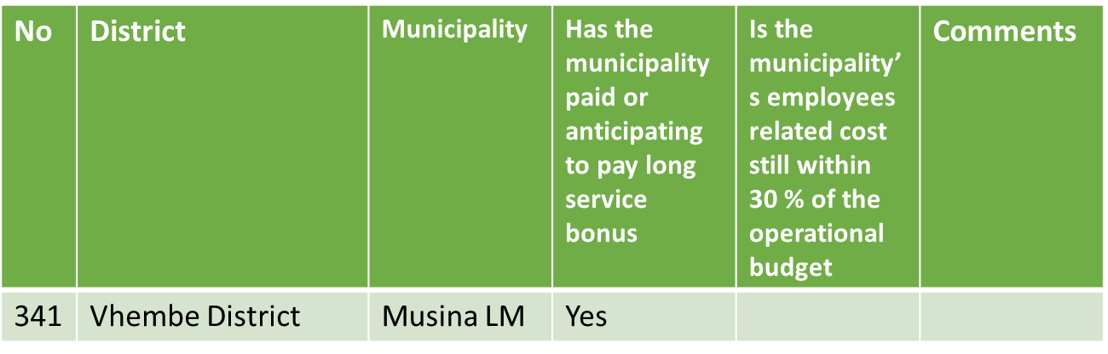
Employees' Status

Slide 12
Filling of Critical posts- @31 December 2022
Elected Council |  |  |  |  |  |  | Executive Management appointment |  |  |  |  |  | Heads of Units
No | Dist | Mun | Mayor | Speaker | CW | Porf Com | MM | CFO | Tech Serv | Com Serv | Corp Serv | EDP | Risk | IA | Budget | Revenue | Exp | Assets
341 | Vhembe | Musina | Filled | Filled | Filled | Filled | Filled | Filled | Filled | Filled | Filled | Filled | Filled | Filled | Filled | Filled | Vac | Filled

Slide 13
Municipal Regulations - Planning
No | District | Municipality | Date of approval of Org Structure | Total Posts on Org Str | Total Filled positions | Total vacant positions
341 | Vhembe | Musina LM | 26/5/22 | 671 | 291 | 380

Slide 14
Municipal Regulations - Implementation
No | Distr | Mun | Awareness to Exec/Top Management | Awareness of all staff | Development or revisio0n of HR Strategy / Plan | Review of HR Policies | Consultation with LLF on the regulation | Adoption of HR Policies by Council | Has the Mun conducted Skills Audit | If yes, indicate date or period of Skills Audit | Is the Mun ready to implement PM for all officials by 1 July 2023
341 | Vhembe | Musina LM | Jan 2023 | 30 March 2023 | 30 March 2023 | 30 March 2023 | Feb 2023 | 30 June 2023 | In process | 2022-2025 | Yes

Slide 15
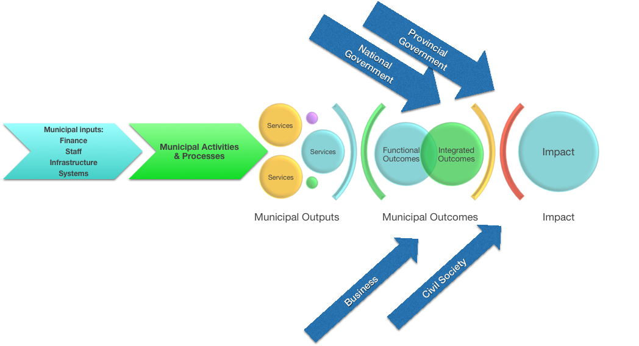
Planning budget and reporting alignment

Slide 16
Planning budget and reporting alignment
The Budget and Treasury strategy is to make sure that resources are utilised fully and equitably as far as possible in line with the strategy and vision of the entire institution.
Each financial year the SDBIP covers all strategic objectives as indicated in the Municipal Integrated Development Plan and budget
Projects are prioritise in the IDP based on stakeholders inputs and are aligned with municipal strategic objectives.
Budget is allocated to projects and approved upon public participation on IDP and Budget.
An IDP review is conducted annually.
The set up municipal objectives are based and aligned with National, provincial and sector plans and alignment is upon those basis..

Slide 17
Planning budget and reporting alignment , reflect the relationship between technical and planning and then BTO
The strategy is not stagnant therefore changes can happen as and when
We are not a pilot for CIDMS/IDMS
The municipality is implementing a Customer Helpdesk to improve service delivery and overtime expenditure. Service providers are to be appointed before the end of the third quarter and departments are currently reviewing service level agreements for service delivery.

Slide 18
Political Management Team meet at least once a week and the Municipal manager attend as per invitation.
(ii) Top management forms part of monthly Executive Committee meetings.
There is a plan to do advertisement of vacancies as prioritised and Section 79 chairpersons play oversight role on municipal departments
The Top Management meet the required competency and relevant qualification
The Performance Agreements where signed at the beginning of financial year and are linked to IDP/SDBIP
Use of consultants Is discouraged but certain usage of them is due to lack of internal skills however there is Value for money; transfer of skills ; mechanisms to monitor the quality of worked performed and consequences for sub standard/non performance. Eg. N-Schedule is signed for Mscoa Budget reform
(iv) There is no any threats to administrative stability apart from the going concern issues , which might cause the institution not to meet its future budgetary commitments
Current institutional arrangement to sustain financial integrity & governance, spatial transformation and drive service delivery
Institutional gaps impending performance

Slide 19
Use of consultants (number of consultants over the last two financial years and the current financial year; Total Rand Value spent over the last two financial years ;the current financial year and committed over the next 6 months Areas/ departments where consultants are deployed and reasons for deployment; Value for money; transfer of skills ; mechanisms to monitor the quality of worked performed by consultants and consequences for sub standard/non performance?

Slide 20
Spatial strategy to address your structural impediments
Local Municipality has development an SDF which is aligned to the provincial and national SDF.
The Municipal SDF has identified the Nodal Points, Activity spine and development corridor as the focal areas for current and future development taking advantage of existing and future Infrastructure.
The same policy has restrict certain development type from Critical Biodiversity Areas to ensure the protection of Natural environment and eco-tourism facilities such as Mapungubwe Heritage Site Kruger national parks
So far, in implementation of the SDF the municipality has done the following :
Musina Local Municipality has approved Limpopo Eco-Industrial Park Town and Extension 1 along the activity spine
Established Rhino-Ridge Park township on the infill zone linking Messina Nancefield Extension 1 and Messina Extension 7 and 8
Currently the has initiated a Township on the infill zone linking Messina Nancefield Extension 6, 10, and 14 with the assistance of CoGHSTA
Given the liquidity status of the municipality, the spatial plans of the municipality are not funded
The municipality has requested and receiving support from the Department of Cooperative Governance, Human Settlement and Traditional Affairs to achieve our spatial planning Objectives.

Slide 21
ii. Reflect how your budget supports this strategy now and overtime;
The municipality is still facing a serious liquidity challenge which has in turn reduced its capacity to annually fund the spatial planning programs and projects identified in the SDF and IDP.
The municipality has approached various entities and government department for assistance.
CoGHSTA has funded the establishment of 826 stands township on the infill zone surrounding Messina Nancefield Extension 6 whilst district municipality has funded demarcation of 200 stands near Masisi Town.
The municipality also made an application to Development Bank of South Africa for funding of Mixed use Township and Urban Renewal Strategy.

Slide 22
Spatial strategy to address your structural impediments Continues……
To reflect on the plans for institutionalising the BEPP process, content, approach, etc
Musina local Municipality will ensure continuous alignment as and when we develop and review of its sector plan to improve implementation

Slide 23
Spatial strategy to address your structural impediments Continues……
iv. Will current service delivery assist the municipality in achieving its spatial transformation outcomes?
Should all sector department and government institution play their role in ensuring that the mandate enshrined in the constitutions are properly carried out and intergovernmental relations is improved, the municipality can achieve its spatial transformation agenda. e.g. provision of sufficient bulk water and sewer system

Slide 24
Spatial strategy to address your structural impediments Continues……
v. Reflect a high level resource plan for your strategy;
Musina LM has partnered with CoGHSTA, Musina Makhado Special Economic Zone Soc. Ltd and other entities to achieve its structural transformation.
That way we are fully involve when others spheres of government and entities develop their strategy to ensures full alignment with the municipal vision and mission
The municipality also take advantage of grant funding available in different spheres of government

Slide 25
Spatial strategy to address your structural impediments Continues……
vi. Reflect your key (external) partners and your (internal) transversal arrangements to enable this;
Municipal Infrastructure Support Agency (MISA) assist with provision of human resource capacity and financial support where possible
Limpopo Department of Transport provide student trainees and develop Local Integrated Transport Plan
Vhembe District Municipality assist with demarcation of stands in rural settlement
DBSA avail grant funding for infrastructure plans, township establishment and etc
CoGHSTA assist with infrastructure development and Township establishment
CoGHTA
Provincial Department of Public Works transfer of various pockets of land for development of public transport infrastructure
Department of Agriculture, Rural Development and Land Reform facilitate for the land rease programs to promote the spatial growth of the municipality

Slide 26
Spatial strategy to address your structural impediments Continues……
vii. Institutional focus for the next 3 years
The municipality has planned to do the following:
develop commercial and residential township to improve their revenue base
Develop Urban renewal Plan/ Strategy to achieve long term development spatial vision and lure investment
Fully implement revenue enhancement strategy and
Forster good partnership with all sector department to ensure continuous assistance

Slide 27
Financial Health
Session 2:
Financial Performance for the 2021/22 & 2022/23 Financial Year

Slide 28
Operating Revenue Performance – 2022/23
LIM341 Musina - Table C4 Monthly Budget Statement - Financial Performance (revenue and expenditure) - M06
 | Ref | 2021/22 | Budget Year 2022/23
 |  | Audited Outcome | Original Budget | Adjusted Budget | monthly Actuals | YearTD actual | YearTD budget | YTD variance | YTD variance | Full Year Forecast
R thousands |  |  |  |  |  |  |  |  | %
Revenue By Source
Property rates |  | 25 661 | 25 814 | 25 814 | 1 799 | 13 229 | 12 907 | 322 | 2% | 25 814
Service charges - electricity revenue |  | 152 800 | 162 728 | 162 728 | 10 554 | 66 752 | 81 364 | (14 612) | -18% | 162 728
Service charges - water revenue |  | 2 |  |  | – |  |  | – |  | –
Service charges - sanitation revenue |  |  |  |  | – |  |  | – |  | –
Service charges - refuse revenue |  | 14 368 | 14 844 | 14 844 | 1 543 | 7 323 | 7 422 | (99) | -1% | 14 844
Rental of facilities and equipment |  | 16 | 558 | 558 | 1 | 5 | 279 | (274) | -98% | 558
Interest earned - external investments |  | – | – | – | – | – | – | – |  | –
Interest earned - outstanding debtors |  | 5 499 | 2 966 | 2 966 | 677 | 12 048 | 1 483 | 10 565 | 712% | 2 966
Dividends received |  | 469 | 527 | 527 | – | – | 264 | (264) | -100% | 527
Fines, penalties and forfeits |  | 5 147 | 3 870 | 3 870 | 281 | 1 088 | 1 935 | (847) | -44% | 3 870
Licences and permits |  | 3 112 | 2 436 | 2 436 | 16 | 207 | 1 218 | (1 011) | -83% | 2 436
Agency services |  |  | – | – | – | – | – | – |  | –
Transfers and subsidies |  | 176 378 | 199 191 | 199 191 | 64 342 | 131 849 | 99 596 | 32 254 | 32% | 199 191
Other revenue |  | 9 036 | 38 108 | 38 108 | 2 534 | 47 703 | 19 054 | 28 649 | 150% | 38 108
Gains |  | (4 190) | - | – | – | – | – | – |  | –
Total Revenue (excluding capital transfers and contributions) |  | 388 298 | 451 042 | 451 042 | 81 747 | 280 204 | 225 521 | 54 683 | 24% | 451 042

Slide 29
Operating Expenditure Performance – 2022/23
LIM341 Musina - Table C4 Monthly Budget Statement - Financial Performance (revenue and expenditure) - M06
 | Ref | 2021/22 | Budget Year 2021/22
 |  | Audited Outcome | Original Budget | Adjusted Budget | Mothly Actuals | YearTD actual | YearTD budget | YTD variance | YTD variance | Full Year Forecast
R thousands |  |  |  |  |  |  |  |  | %
Expenditure By Type
Employee related costs |  | 150 650 | 162 265 | 162 265 | 13 610 | 74 917 | 81 133 | (6 216) | -8% | 162 265
Remuneration of councillors |  | 10 097 | 12 823 | 12 823 | 870 | 5 146 | 6 412 | (1 266) | -20% | 12 823
Debt impairment |  | 41 885 | 38 307 | 38 307 | – | – | 19 154 | (19 154) | -100% | 38 307
Depreciation & asset impairment |  | 31 885 | 27 942 | 27 942 | – | – | 13 971 | (13 971) | -100% | 27 942
Finance charges |  | 135 | – | – | – | – | – | – |  | –
Bulk purchases |  | 137 919 | 121 518 | 121 518 | 52 684 | 65 018 | 60 759 | 4 259 | 7% | 121 518
Other materials |  | 4 200 | 2 993 | 2 993 | 172 | 1 257 | 1 497 | (240) | -16% | 2 993
Contracted services |  | 35 198 | 38 078 | 38 078 | 8 393 | 14 213 | 19 039 | (4 826) | -25% | 38 078
Transfers and subsidies |  | 5 827 | – | – | 378 | 2 251 | – | 2 251 | #DIV/0! | –
Other expenditure |  | 31 607 | 42 115 | 42 115 | 12 845 | 23 608 | 21 058 | 2 551 | 12% | 42 115
Losses |  |  | – | – | – | – | – | –
Total Expenditure |  | 449 403 | 446 041 | 446 041 | 88 952 | 186 410 | 223 021 | (36 611) | -16% | 446 041

Slide 30
Cash Flow 2022/23
LIM341 Musina - Table C7 Monthly Budget Statement - Cash Flow - M06 December
Description | Ref | 2021/22 | Budget Year 2022/23
 |  | Audited Outcome | Original Budget | Adjusted Budget | Monthly actual | YearTD actual | YearTD budget | YTD variance
R thousands | 1
CASH FLOW FROM OPERATING ACTIVITIES
Receipts
Property rates |  | – | 23 486 | – | 1 799 | 11 923 | 11 743
Service charges |  | 72 168 | 159 815 | – | 10 554 | 61 439 | 79 908
Other revenue |  | 95 500 | 9 771 | – | 6 590 | 14 494 | 4 886
Transfers and Subsidies - Operational |  | 129 975 | 196 191 | – | 63 779 | 143 047 | 98 096
Transfers and Subsidies - Capital |  | – | 32 713 | – | 7 500 | 28 563 | 16 357
Interest |  | – | – | – | 677 | 11 059 | –
Dividends
Payments
Suppliers and employees |  | (34 519) | (379 098) | – | (35 709) | (257 771) | (189 549)
Finance charges |  | – | – | – |  |  | –
Transfers and Grants |  | – | (4 390) |  | (78) | (585) | (2 195)
NET CASH FROM/(USED) OPERATING ACTIVITIES |  | 263 124 | 38 488 | – | 55 112 | 12 169 | 19 244
CASH FLOWS FROM INVESTING ACTIVITIES
Receipts
Proceeds on disposal of PPE |  | 1 991 | – | – |  |  | –
Decrease (increase) in non-current receivables
Decrease (increase) in non-current investments
Payments
Capital assets |  | (22 525) | (37 713) | – | (200) | (10 808) | (18 857)
NET CASH FROM/(USED) INVESTING ACTIVITIES |  | (20 534) | (37 713) | – | (200) | (10 808) | (18 857)
CASH FLOWS FROM FINANCING ACTIVITIES
Receipts
Short term loans |  |  | – |  |  |  | –
Borrowing long term/refinancing |  | – | – |  |  |  | –
Increase (decrease) in consumer deposits |  | 304 | – |  |  |  | –
Payments
Repayment of borrowing |  | (384) | – |  | – | – | –
NET CASH FROM/(USED) FINANCING ACTIVITIES |  | (80) | – | – | – | – | –
NET INCREASE/ (DECREASE) IN CASH HELD |  | 242 510 | 775 | – | 54 912 | 1 361 | 388
Cash/cash equivalents at beginning: |  | 22 867 | 12 473 | – |  | 2 663 | 12 473
Cash/cash equivalents at month/year end: |  | 265 377 | 13 248 | – |  | 4 024 | 12 861

Slide 31
Audited Financial Performance – (2016/17 - 2021/22)
Municipality - Key indicators
Performance Indicator | 2017/18 | 2018/19 | 2019/20 | 2020/21 | 2021/22
 | Audited Outcome | Audit Outcomes | Audit Outcomes | Audit Outcomes | Audit Outcome
Operating revenue | 260,903,402 | 289,477,056 | 340 964 946 | 397 370 667 | 396 872 841
Operating expenditure | 363,032,112 | 358,685,396 | 398 317 005 | 414 613 787 | 451 283 379
Operating surplus/ deficit | -63,752,172 | -69,208,339 | -57 352 059 | -17 243 120 | -54 410 538
Capital expenditure | 26,531,913 | 23,659,334 | 27 44 083 | 37 793 234 | 31 407 538
Conditional grants performance | '69% | '81% | ‘93% | 97% | 85%
Cash/cash equivalents at the year end | 2,624,615 | 1,453,471 | 12 667 402 | 12 473 161 | 5 715 066
Collection rate | '75% | '72% | '72% | '72%
Cash/ Cost coverage ratio
Debt to revenue ratio | '0.69 | '0.78 | '0.78 | '0.78
Current ratio | '0.53 | '0.53 | '0.53 | '0.53 | 0.18
Outstanding debtors | 179,669,897 | 226,185,801 | 19 779 587 | 24 135 584 | 31 075 059
Outstanding creditors | 230,073,450 | 544,411,185 | 299 628 601 | 325 889 022 | 518 029 801
Cost coverage

Slide 32
Financial Recovery Plan
Revenue enhancement strategy to be implemented fully and consideration to effect more revenue streams in our tariff structure in the 2022/2023 budget.
Implementation of cost cutting measures and adherence to the cost containment policy.
Progress on Cost containment is the approval of the policy and further reduction on excessive overtime to be limited to 40hrs per month per individual.
Adherence to the payment plans in respect of prior year debts

Slide 33
Cost Containment

Slide 34
Distribution Losses

Slide 35
Auditor Financial Performance – 2022/23
Audit Opinion
2017/18 | 2018/19 | 2019/20 | 2020/21
Qualified | Qualified | Unqualified | Unqulaified

Slide 37
Property Valuation and Rating

Slide 38
FINANCIAL GOVERNANCE 3

Slide 39
Special Adjustment Budget
Did the municipality pass a special adjustment budget to authorise the previous year’s unauthorised expenditure in line with section 32 of the MFMA and Regulation 23 of the Municipal Budget and Reporting Regulations?
No there was no special adjustment budget to authorise previous year’s unauthorised expenditure
Please provide details including the amount authorised, and the date the adjustment budget was passed.
None

Slide 40
1.2. Conditional Grant Performance

Slide 41
Conditional Grant Performance – 2021/22
Description | Ref | 2020/21 | Budget Year 2021/22
 |  | Audited Outcome | Original Budget | Adjusted Budget | Monthly actual | YearTD actual | YearTD budget | YTD variance | YTD variance
Operating expenditure of Transfers and Grants
National Government: |  | 199,644 | 174,429 | – | 57,431 | 130,784 | 87,215 | 43,569 | 50.0%
Local Government Equitable Share |  | 195,305 | 169,864 |  | 56,621 | 127,398 | 84,932 | 42,466 | 50.0%
Finance Management |  | 2,700 | 2,850 |  | 810 | 1,671 | 1,425 | 246 | 17.2%
EPWP Incentive |  | 1,639 | 1,715 |  | – | 1,715 | 858 | 858 | 100.0%
 |  |  |  |  |  |  |  | –
Capital expenditure of Transfers and Grants
National Government: |  | 37,793 | 36,988 | – | 196 | 17,335 | 15,412 | 1,923 | 12.5%
Municipal Infrastructure Grant |  | 37,793 | 36,988 |  | 196 | 17,335 | 15,412 | 1,923 | 12.5%
TOTAL EXPENDITURE OF TRANSFERS AND GRANTS |  | 237,437 | 211,417 | – | 57,627 | 148,119 | 102,626 | 45,493 | 44.3%

Slide 42
Conditional Grant Performance - 2019/20, 2020/21 and 2021/22
Unspent conditional grants:
 | 2019/2020
 | R
 | Opening Balance | Funds Received | Funds Utilised | Closing Balance
INEP | 6,820,202 | 3,100,000 | 9,920,202 | -
MIG | 2,531,116 | 29,016,000 | 27,174,882 | 4,372,234
Total | 9,351,318 | 32,116,000 | 37,095,084 | 4,372,234
 | 2020/2021
 | R
 | Opening Balance | Funds Received | Funds Utilised | Closing Balance
INEP | - | - | - | -
MIG | 4,372,234 | 33,421,000 | 37,793,234 | -
Total | 4,372,234 | 33,421,000 | 37,793,234 | -

Slide 43
Conditional Grant Performance – 2016/17 – 2020/21 (5 years)

Slide 44
Provide high level summary per Grant allocated with more focus on:
The municipality has received all transfers as per payment schedule. The municipality has received R127 million for equitable share, R2, 8 million for FMG and R1.2 million for EPWP
The has spent 100% of the received allocation of EPWP and 59% on FMG, the Municipality will spend the entire allocation by year end.
The total capital budget is R44.9 million for 2021/22 current year, and we have received R26.9 million of the MIG grant allocation so far, and spend R 17.3 million of the grant in the last half of the financial year. The municipality is confident that by year end the grant will be on 100%.
The municipality has spend 100% of its Grant allocation no Roll Over

Slide 45
22/23 Adjustment Budget Estimate Proposal

Slide 46
ADJUSTED REVENUE 2022/2023
ADJUSTMENT BUDGET PROJECTION 2023
INCOME
 | ORIG BUDGET | AFS 2021/22 | SYSTEM BUDGET | ACTUAL | OVER/UNDER | ENVISAGED ADJBUD 2022/2023
Property rates | 25 814 000.00 | 25 683 932.78 | 25 814 000.00 | 13 799 000.00 | 12 015 000.00 | 25 814 000.00
Electricity Charges | 162 074 000.00 | 167 348 217.96 | 162 074 000.00 | 66 493 872.00 | 95 580 128.00 | 162 074 000.00
Refuse | 15 498 000.00 |  | 15 498 000.00 | 9 140 673.00 | 6 357 327.00 | 15 498 000.00
Rental | 558 000.00 | 692 930.55 | 558 000.00 | 176 311.00 | 381 689.00 | 558 000.00
Interest- External | 527 000.00 | 469 108.79 | 527 000.00 | - | 527 000.00 | 527 000.00
Interest- Outstanding debtors | 2 966 000.00 | 4 963 673.05 | 2 966 000.00 | 11 722 000.00 | -8 756 000.00 | 2 966 000.00
Fines | 3 870 000.00 | 3 122 500.00 | 3 870 000.00 | 1 493 000.00 | 2 377 000.00 | 3 870 000.00
Licence and Permits | 2 436 000.00 | 2 098 990.95 | 2 436 000.00 | 52 000.00 | 2 384 000.00 | 2 436 000.00
Operational Transfers | 199 191 000.00 | 174 428 999.96 | 199 191 000.00 | 143 569 000.00 | 55 622 000.00 | 199 191 000.00
Other revenue | 38 108 000.00 | 18 064 486.72 | 38 108 000.00 | 19 230 000.00 | 18 878 000.00 | 38 108 000.00
Gains on disposal of PPE | - | -2 310 000.00 |  | - | - | -
TOTAL | 451 042 000.00 | 394 562 840.76 | 451 042 000.00 | 265 675 856.00 | 185 366 144.00 | 451 042 000.00

Slide 47
ADJUSTED EXPENDITURE 2022/23
EXPENDITURE
 | ORIG BUDGET | AFS 2021/22 | SYSTEM BUDGET | ACTUAL | OVER/UNDER | ENVISAGED ADJBUD 2022/2023
Employee costs | 162 265 000.00 | 151 682 716.21 | 162 265 441.00 | 74 917 000.00 | 87 348 000.00 | 162 265 000.00
Remuneration of councillors | 12 822 000.00 | 10 097 006.89 | 12 822 597.00 | 5 146 000.00 | 7 676 000.00 | 12 822 000.00
Depreciation & asset impairment | 27 942 000.00 | 31 884 997 | 27 942 428.00 | - | 27 942 000.00 | 27 942 000.00
Debt Impairment | 38 307 000.00 | 41 885 422.72 | 38 307 000.00 |  |  | 38 307 000.00
Finance charges | - | 121 724 |  |  | - | -
Materials and bulk purchases | 121 518 000.00 | 137 919 076.26 | 121 518 000.00 | 123 780 000.00 | -2 262 000.00 | 121 518 000.00
Contracted Services | 38 078 000.00 | 37 408 168.78 | 38 078 000.00 | 13 471 559.50 | 24 606 440.50 | 38 078 000.00
Transfers and grants | - | 4 565 000.00 | 1 493 179.00 | 1 493 179.00 | -1 493 179.00 | -
Other expenditure | 41 615 000.00 | 31 519 060.13 | 41 615 000.00 | 23 606 000.00 | 18 009 000.00 | 41 615 000.00
Inventory Consumed | 3 493 000.00 | 4 200 207.07 | 3 493 892.00 | 1 019 660.00 | 2 473 340.00 | 3 493 000.00
Loss on Disposal of Assets |  | - |  |  | - | -
TOTAL | 446 040 000.00 | 451 283 378.71 | 447 535 537.00 | 243 433 398.50 | 164 299 601.50 | 446 040 000.00

Slide 48
The above Adjustment Budget projections has consideration emanating from the MTREF Budget Assessment and Benchmark Engagement and has been tabled in Council with the original budget for approval prior to the approval of the Adjustments Budget.
  essentially the Municipal Budget Assessment and Benchmark Engagement recommendations for the 2021/22 MTREF should be considered as part of the finalization of the 2022/23 MTREF. Yes they were considered.
  In cases where these recommendations were not tabled in Council and/or not considered during the compilation of the 2022/23 financial year Adjustments Budget, the municipality is required to provide reasons for this omission2022/23 Budget preparation. The recommendations were tabled in council.

Slide 49
2023/24 Budget preparation

Slide 50
PLANNING ACTIVITY | TIME SCHEDULE
Approval of Budget time schedule | 26 August 2022 DONE
Income Budget Submission | 28/29 September 2022 DONE
Departmental Budget Submission (Budget and business Plans) | 18 October 2022 DONE
Departmental Budget meeting with Municipal manager | 15 November 2022 DONE
Budget meeting | 3 March 2023
Tabling of first draft Budget, SDBIP (Service delivery Budget implementation plan) | 23 March 2023
Provincial Treasury session on draft budget | To be announce
Upload budget on municipal website and SMS distribution for budget reviews and public input at satellite offices and municipal offices. | 3 April 2023 -28 April 2023
Provincial Treasury budget engagements | May 2023
Tabling Final Budget, SDBIP | 19 May 2023
Budget speech and Approval of Budget and SDBIP | End June 2022
Submission of approved budget to National Treasury, Provincial Treasury and Other Stakeholders | On or Before 14th June 2023

Slide 51
Status of 2022/23 Budget preparation
The Municipality has tabled the 2023/24 Budget Process Schedule in Council on 27 August 2022.
Yes the milestones were followed as per the Budget process schedule.
Yes the benchmark is scheduled for May of 2023 has been included in the Budget process schedule.

Slide 52
Session 3
Financial Governance
Auditor General’s findings as reported for the 20/21 financial year

Slide 53
Auditor General report – 2020/21
3.1 Audit Outcome Trend
Audit Opinion
2017/18 | 2018/19 | 2019/20 | 2020/21
Qualified | Qualified | Unqualified | Unqulaified

Slide 54
Audit Findings
List the audit findings reflected in the audit report
Audit finding | Recurring finding |  |  |  | Root cause of finding (2018/19) | Remedial action to address audit finding | Timeframe | External/ Internal Resources (name of department or name of consultant) | Progress to date
 | 2016/7 | 2017/18 | 2018/19 | 2019/20
1. PPE |  | x | X |  | Assets policy not followed | Evaluate the usefulness of assets | 30/06/2020 | In house | Being addressed
2. Non exchange transactions |  | x | X |  | Transactions not corresponding | Address the water transaction with VDM | 30/06/2020 | VDM | Being addressed
3. Going concern |  | x | X |  | Revenue management | Improve revenue collections | 30/06/2020 | VDM | Being addressed

Slide 55
Monitoring of audit action plans
Role of management (Accountability lies with management)
MLM has developed systems of internal control which are approved by Council
Departments in their monthly meetings monitors the implementation of the audit action plan to address the findings raised
During the monthly meetings
Recommendations of the AGSA, internal audit and NT are recorded in the registers to monitor the implementation thereof –
Matters of audit are reflected in management’s KPI’s (relating to their area of work)
Role of Assurance Providers( Internal audit and Audit Committee)
The audit action plan reviewed on a monthly basis by management and the progress thereon is submitted quarterly to the audit committee
Internal audit review the progress on the action plan quarterly and submit feedback to management and the audit committee
The audit committee report to Council quarterly on the progress of the audit action plan

Slide 56
Monitoring of audit action plans
Role of Assurance Providers( Internal audit and Audit Committee)
The audit action plan reviewed on a monthly basis by management and the progress thereon is submitted quarterly to the audit committee
Internal audit review the progress on the action plan quarterly and submit feedback to management and the audit committee
The audit committee report to Council quarterly on the progress of the audit action plan
The AG Action plan is a standing item in senior management meeting, EXCO, Audit Committee and monitoring is coordinated by the Risk Management Unit.
Recommendations made by AGSA, internal audit and NT are implemented

Slide 57
Audit Findings
Audit finding | Recurring finding |  |  |  | Root cause of finding (2018/19) | Remedial action to address audit finding | Timeframe | External/ Internal Resources (name of department or name of consultant) | Progress to date
 | 2016/17 | 2017/18 | 2018/19 | 2019/20
1. PPE |  | X | X | ? | Assets policy not followed | Evaluate the usefulness of assets | 30/06/2021 | In house | Being addressed
2. Non exchange transactions |  | X | X | ? | Transactions not corresponding | Address the water transaction with VDM | 30/06/2021 | VDM | Being addressed
3. Consequence Management |  | X | X | ? | Cases of UIF & W are not followed up | FMB to investigate cases of UIF & W expenditures | 30/06/2021 | In house | Being addressed

Slide 58
Use of consultants – Summary as at 31 Dec 2022

Slide 59
Expenditure Per Department
Contracted Value 2022/2023 | Office of Municipal Manager | Corporate Services | Financial Services | Community Services | Technical Services | Economic Development and Planning | Other
93 394 078 | 29 875 206 | 3 162 779 | 41 138 065 | 11 195 188 | 8 022 841 | 0 | 0

Slide 60
Expenditure Per Section
Contracted Value 2022/2023 | AFS | Fixed Assets | Valuation Roll | UIF&W | Municipal Financial System | Vat | Data Cleansing & Integrity | IT Services | Engineering services | SCM services | Security services | Other Services
93 394 078 | 0 | 2 231 920 | 0 | 0 | 25 646 394 | 13 117 642 | 0 | 1 207 377 | 8 022 841 | 0 | 29 875 206 | 13 292 698

Slide 61
Expenditure Per Gap Analysis Area
Contracted Value 2022/2023 | Skill is not in place in the Municipality | Skill is partially in place | Staff shortages – internal capacity | Other
93 394 078 | 78 044 516 | 15 349 562

Slide 62
Use of consultants – Detail as at 31 Dec 2022
Insert a link of the Use of consultants reporting as at 31 December 2022

Slide 63
Risk Management
Risk management committee chaired by an independent person is in place, scheduled to meet and report quarterly. The RMC comprises of the following:
  Independents chairperson
  HOD’s
  Risk Manager
  Internal Audit (Standing invitees)
Maturity of risk management at the municipality: Maturity rating 3: Compliant risk management level
Key risk indicators:
Financial – Unfunded budget due to Low collection rate, High Trade payables e.g. Eskom debt etc…
Human resource – Non-compliance with Municipal staff regulations, Low staff moral, Low productivity, High vacancy rate etc…
Operational - Lack of proper ICT equipment and connectivity; System failures; ICT security breaches; Eskom Load-shedding etc.…
Environmental- Climate change, population growth, natural disasters etc.

Slide 64
Risk Management
  The municipality conducts risk assessments annually.
  An emerging risk register template is circulated to departments on a quarterly basis
  The risk assessment is conducted using the Group systems approach. Group Systems is a tool used to enhance interactive group activities such as brainstorming, categorizing and voting. A Group Systems business risk assessment results in the identification and rating of business risks.
  During Group Systems meetings, participants identify “Risks" using specific words or phrases. Risks identified were recorded in the risk schedule and rated in terms of likelihood and impact.
PROCESS FOLLOWED
  The process followed during the sessions is outlined as follows:
  Identification of Strategic objectives
  Risk Identification
  Inherent Risk Ranking (impact and likelihood)
  Identification of current controls
  Residual risk exposure
  identification of risk mitigating factors
  Identification of risk owners
  Time frames

Slide 65
  MLM has a Risk Management Committee(RMC) that was established by the Accounting Officer for the 2022/23 Financial year. The committee has met 2 times as at 31st December 2022.
  The chairperson provides a report to the Accounting Officer and the Audit Committee on the status of risk management in the municipality.

Slide 66
2022/23 Risk Register
STRATEGIC OBJECTIVE | RISK DESCRIPTION AT STRATEGIC OBJECTIVE | CAUSE | ACTIONS TO IMPROVE MANAGEMENT OF THE RISKS | TARGETED DATE
To initiate and improve the quantity and quality of municipal infrastructure and services | Service interruptions (Electricity) | 1. Ageing infrastructure. 2. Limited bulk service capacity. 3. Services theft (cable theft, electricity theft) | 1. Engage with DBSA regarding progress on procurement of professional services provider 2.Upgrade electrical lines on an ADHOC basis 3. Engage with Eskom on the process to follow on increasing bulk supply 4. Conduct meter audits and illegal connection campaigns | 1. 30 June 2023 2. Quarterly 3. 30 June 2023 4. Quarterly
To deepen democracy and promote accountability | Unfulfilled municipal service level expectation | Lack of service standards | 1. Institute standards of service delivery 2. Monitor the delivery of services to ensure the meeting and exceeding of standards | Quarterly
 | Non compliance to Mscoa | 1. Lack of capacity 2. Delay in integration of sub- systems | 1. Training of end users to perform duties electronically | Quarterly

Slide 67
STRATEGIC OBJECTIVE | RISK DESCRIPTION AT STRATEGIC OBJECTIVE | CAUSE | ACTIONS TO IMPROVE MANAGEMENT OF THE RISKS | TARGETED DATE
Enhance compliance with legislation and improve financial viability | Inability to sustain the institution financially. | 1. Inability to explore other revenue streams. 2. Increase in debtors. 3.Services theft. 4.Ineffective cost structure. 5. Excessive over-time 6. Non-recovery of outstanding debts 7. Spending on non-priorities | Billing of businesses and departments in villages. | On-going
Enhance compliance with legislation and improve financial viability | MFMA sec 32 (Unauthorized, Irregular and Fruitless & wasteful expenditure). | 1. Non compliance to SCM regulations. 2. Interest charged due to Non payment of creditors within the prescribed timeframe. 3.Overspending on the approved budget. 4. Lack of consequence management. 5. Lack of adequate investigation of MFMA section 32 in order to determine root cause etc | 1. Conduct awareness on sect 32 requirements 3. Implementation of consequence management (FMB recommendations). | Quarterly
 | Fraud and Corruption | 1. Lack of consequence management. 2.Weakness in internal controls 3. Collusion. 4. Non-compliance to laws and regulations 5. Lack of segregation of duties | 1. Conduct regular ethics and fraud awareness campaigns (quarterly) via Facebook page, bulk smses and website 2.Investigate reported fraud and corruption related cases and communicate the outcome | Quarterly

Slide 68
STRATEGIC OBJECTIVE | RISK DESCRIPTION AT STRATEGIC OBJECTIVE | CAUSE | ACTIONS TO IMPROVE MANAGEMENT OF THE RISKS | TARGETED DATE
Enhance compliance with legislation and improve financial viability | Breach of contractual obligations by service providers | Inadequate / Lack of contract management (Lack of monitoring and reporting on performance of service providers ) | Monitor and report performance of all service providers on a quarterly basis. | On-going
To create a conducive environment for sustainable economic growth | Inability to attract investors | 1. Insufficient government owned land. 2. Insufficient bulk infrastructure services 3. Inability to access private owned land | 1. Review LED Strategy 2. Transfers of government owned land to municipalities 3. Ongoing engagement between with the Minister, VDM and Department of Water and Sanitation on the infrastructure. | 1. 30 June 2023 2. 30 June 2023 3. 30 June 2023
 | Lack of integrated planning | 1. Lack of support from stakeholders. 2. Unavailability of stakeholders during IDP meetings. 3. Non-adherence of IDP and Budget process plan | Adhere to District Development Model | Quarterly

Slide 69
STRATEGIC OBJECTIVE | RISK DESCRIPTION AT STRATEGIC OBJECTIVE | CAUSE | ACTIONS TO IMPROVE MANAGEMENT OF THE RISKS | TARGETED DATE
To create a conducive environment for sustainable economic growth | Loss of municipal land | Illegal land occupation and land encroachment | 1. Enforcement of the Land Use Management Scheme 2. Continue with the current control: a. Removal off illegal occupants within 48 hours b. Cutting off of fences | 1.Quarterly 2. Quarterly
To increase institutional capacity, efficiency and effectiveness | Ineffective organizational structure | Lack of alignment of the organizational structures to powers and functions of the municipality | Annual review of current organisational structure | 30 June 2023
To improve the quality of lives through social development and the provision of effective community services | Disasters | 1. Acts of nature 2. Man made disasters | Continue with the current control: 1.Implementation of Disaster Management Plan 2.Conduct regular awareness on the identified disasters as per the reviewed disaster plan | Quarterly 2. Quarterly

Slide 70
MPAC

Slide 71
3.2. Financial Misconduct Procedures and Criminal procedures
Consequence management in terms of Chapter 15 of the MFMA and the Municipal Regulations on Financial Misconduct

Slide 72
Consequence Management
The presentation must cover:
  Confirm the establishment a disciplinary board as required in terms of Reg 4 of the Municipal Regulations on Financial Misconduct Procedures and Criminal Proceedings and the date of establishment. If not established, provide reasons why.
  Yes the disciplinary board is established, council resolution number 10.5.11.2017
  Whether the municipality has terms of reference for the disciplinary board.
Cases of Financial Misconduct addressed during 2019/20
Position | Nature of alleged financial misconduct (Details of the non-compliance) | Date when matter referred to the disciplinary board for investigation | Outcome of investigation | Comments
None | None | None | None

Slide 73
3.3 Special Adjustment Budget to authorise Unauthorised Expenditure in terms of section 32 of the MFMA and Regulation 23 of the MBRR

Slide 74
Special Adjustment Budget
Did the municipality pass a special adjustment budget to authorise the previous year’s unauthorised expenditure in line with section 32 of the MFMA and Regulation 23 of the Municipal Budget and Reporting Regulations?
No there was no special adjustment budget to authorise previous year’s unauthorised expenditure
Please provide details including the amount authorised, and the date the adjustment budget was passed.
None

Slide 75
The presentation must also address whether the recommendations of the disciplinary board have been implemented.
There were no cases.
If there were no cases dealing with financial misconduct, explain why.
The committee were trained by LPT on 27/10/2021
Provide details of cases reported to the SAPS during 2020/21.
No Cases.

Slide 76
3.4 Addressing Unauthorised, Irregular, Fruitless and Wasteful Expenditure during 2019/20

Slide 77
Addressing Historical Unauthorised Expenditure
Unauthorised Expenditure processed in terms of section 32(2)(a)(ii) of the MFMA
Amount | Root cause/s | FY to which the amounts relates | Date referred to MPAC for investigation | Date MPAC report tabled in council | Amount written-off | Amount recovered | Amounts still to be processed
none | none | none | none | none | none | none | none

Slide 78
Addressing Historical Irregular Expenditure
Irregular Expenditure processed in terms of section 32(2)(b) of the MFMA
Amount | Root cause/s | FY to which amount relates | Date referred to MPAC for investigation | Date MPAC report tabled in council | Amount written-off | Amount recovered | Amounts still to be processed
None | none | none | none | none | none | none | none

Slide 79
Addressing Historical Fruitless and Wasteful Expenditure
Fruitless and Wasteful Expenditure processed in terms of section 32(2)(b) of the MFMA
Amount | Root cause/s | FY to which the amounts relates | Date referred to MPAC for investigation | Date MPAC report tabled in council | Amount written-off | Amount recovered | Amounts still to be processed
none | none | none | none | none | none | none | none

Slide 80
Addressing the Unauthorised, Irregular, Fruitless and Wasteful Expenditure identified in-year (during 2019/20
The item to serve in Council after MPAC Recommendations towards the end of MARCH 2022

Slide 81
Reporting on implementation UIFW reduction strategy, Reduction Plan
Reduction plan | Baseline (2018/19 audited) | Year 1 | Year 2 | Year 3 | Year 4 | Year 5
Percentage reduction |  | -10% | -20% | -30% | -40% | -50%
Unauthorised expenditure | R100 000 (as an example) | R90 000 | R80 000 | R70 000 | R60 000 | R50 000
Percentage reduction
Irregular expenditure
Percentage reduction
Fruitless & Wasteful expenditure

Slide 82
Reporting on implementation UIFW reduction strategy ,Reduction Plan
Add: Irregular expenditure 2019/20 (unaudited AFS)
Add: irregular expenditure 2019/20 (identified by AGSA)
Less: Written off 2019/20
Less: Recovered 2019/20
Add: irregular expenditure (Q1: July to September 2020)
Add: irregular expenditure (Q2: October to December 2020)
Add: irregular expenditure (Q3: January to March 2021)
Add: irregular expenditure (Q4: April to June 2021)
Less: Written off (Q1: July to September 2020)
Less: Written off (Q2: October to December 2020)
Less: Written off (Q3: January to March 2021)
Less: Written off (Q4: April to June 2021)
Less: Recovered (Q1: July to September 2020)
Less: Recovered (Q2: October to December 2020)
Less: Recovered (Q3: January to March 2021)
Less: Recovered (Q4: April to June 2021)
Closing balance
TOTAL

Slide 83
Progress report for the funding plan(those with unfunded budget)
Report on implementation of the funding plan

Slide 84
MSCOA - Business process & systems alignment
Is this treated as a business reform?
Yes it is treated as a business reform and is having a standing item at every HoD
What is the involvement of different departments within the municipality?
Through the HOD meeting and budget process the entire departments are kept abreast
Reflect on your progress with mSCOA reflecting on the implications of not being up to date with the reform?
Currently addressing process gaps, and system knowledge through interaction with service
provider
Reflect a road map to indicate how and by when the municipality will become mSCOA
compliant.

Slide 85
mSCOA Governance
Is the required government structures in place to drive and ensure successful implementation of the reform?
Focus Area | Yes / No | Provide reasons for non-compliance | Future plans
Is the mSCOA steering committee (Steercom) in place? | Yes
Are all HODs part of the Steercom? | Yes
Does the MM chair the meetings? | Yes
Does the Steercom meet at least monthly? | No
Are progress and challenges on mSCOA implementation, as discussed at the Steercom, presented to EXCO and relevant council committees? | Yes | Only taken to HOD’s | Taken to EXCO and relevant council committees
Are progress and challenges on mSCOA implementation, as discussed at EXCO and relevant council committees, presented to Council quarterly? | No | Only discussed at HOD’s meetings. | Extended to EXCO and relevant council committees

Slide 86
mSCOA Implementation
Is the required government structures in place to drive and ensure successful implementation of the reform?
Focus Area | Yes / No | Provide reasons for non-compliance | Future plans
Is the budget module fully utilised to prepare the budget? | Yes
Is budgeting in accordance with full mSCOA chart? | Yes
Is transacting performed within the system across all functionalities? | Partially | Transacting offline and manually | To transact online daily.
Are statutory reports generated directly from the system? | Yes

Slide 87
mSCOA implementation
>Municipality to demonstrate how cash flow tables are populated using datastrings:
  The data strings are created on the financial management system (Munsoft) and the imported to the reporting tool (caseware) which then populates the cash flow tables.
> Municipality to articulate challenges to populate cash flow tables:
> The following challenges are encountered on the cash flows:
  Financial Management System – The financial management system populates the cash flow via their balance sheet budgeting module which links the item segment from the income statement to the item segment on the balance sheet which is fundamentally incorrect.
> The financial management system does not allow for collection rates on revenue
> The financial management system does not allow for delays on payments to suppliers on expenditure
National treasury is not consistent on the population of the cash flow. Revenue is populated with the funding segments and the expenditure is populated with the item segment.
> Budgeting, reporting etc. on the conditional grants
The condition grants module is relatively new on the financial management system and there are still teething issues and reporting on conditional grants are not reliable

Slide 88


Slide 89
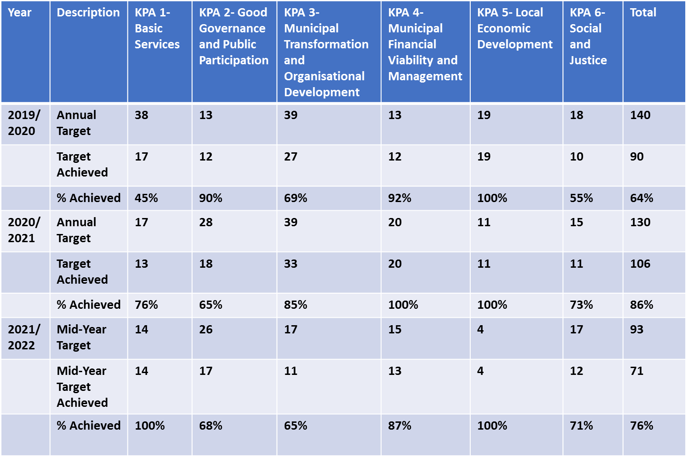
Service Delivery Performance (SDBIP) – 2019/20 - 2021/22
Reasons for deviations:
Budget/Cash flow constrains
SCM Delays
Delay in construction schedule
Service needs

Slide 90
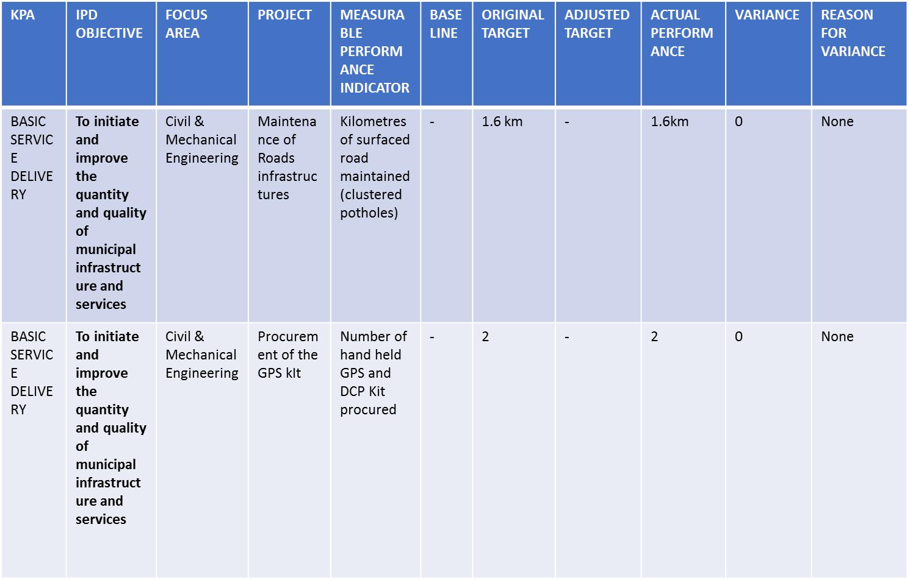
Service Delivery Performance (SDBIP) - 2021/2022

Slide 91
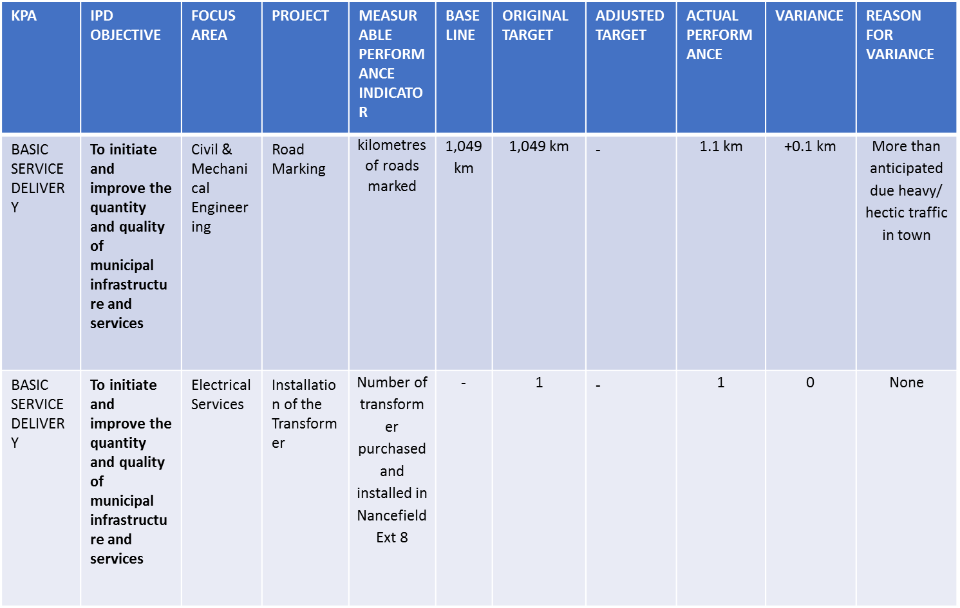
Service Delivery Performance (SDBIP) – 2021/2022

Slide 92
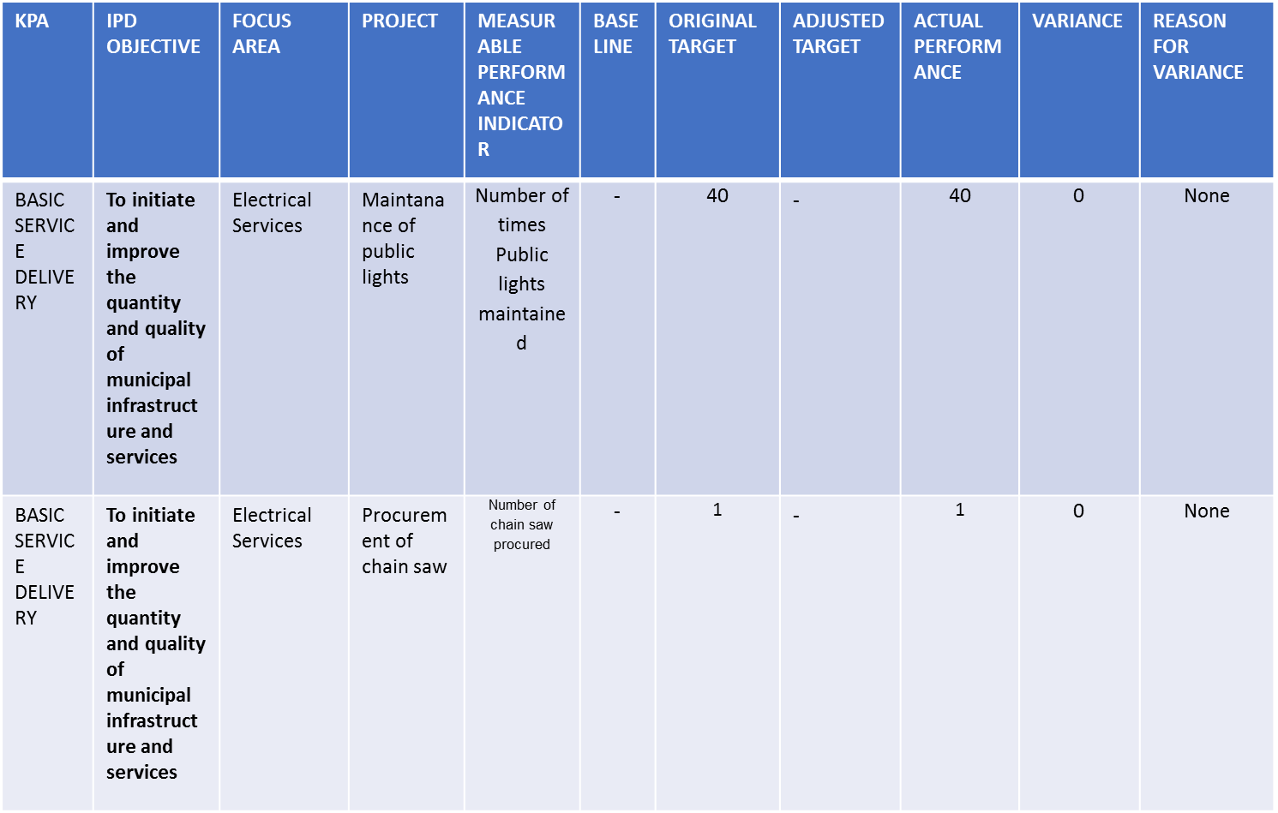
Service Delivery Performance (SDBIP) - 2021/2022

Slide 93
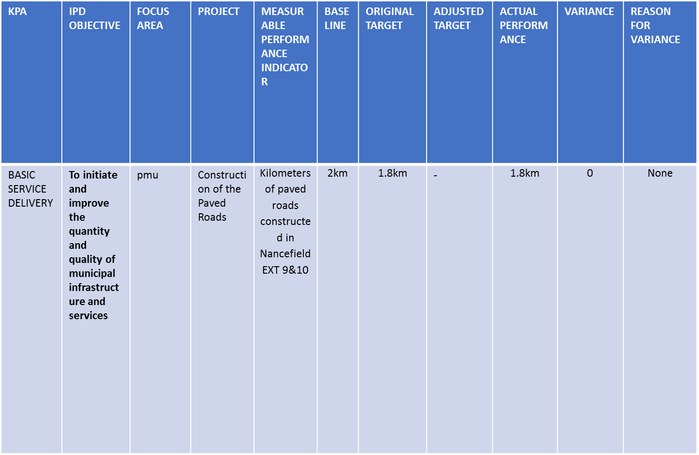
Service Delivery Performance (SDBIP) – 2021/2022

Slide 94
Electricity losses mitigation strategy
Loss Mitigation Strategy (Electricity)
Technical Losses:
Installation of power factor correction equipment at the strategic positions.
Installation of substation monitoring devices (quality of supply)
Non-Technical Losses:
Identification and classification of the different consumers and their different tariffs.
Conduct regular meter inspections.

Slide 95
COMPLETED PROJECTS
Construction of Nacefield ext. 2 & 8 paved road
Construction of Nancefield Multipurpose Centre
Construction of Nancefield Storm water
Construction of Nancefield ext. 9 & 10 paved road

Slide 96
Site visits presentation - 2018/19 – 2019/20
Electrification projects:
Tshikudini
The contractor name is Nthambe Electrical.
The project progress is at 90% construction.
All materials were purchased and supplied on site.
Construction is in progress and the completion date will be before 28 February 2021.
Tanda
The contractor name is Magekha Electrical
The construction progress is at 91%
The outstanding issue is for the contractor to book an inspection date with ESKOM in order to complete closing spans.

Slide 97
Water losses mitigation strategy
Loss Mitigation Strategy (Water)
(1) Work stream – Bulk Water Supply & Bulk Meters
Objective:
Provide bulk water balances to proactively establish accurate assessment of water losses in bulk water supply system
Replace/upgrade old infrastructure
Ensure adequate working bulk meters at all required supply points
(2) Assistance to the Poor and School Leak Repairs
Objective:
Ensure that internal water losses are identified and repaired
(3) Leak Repair Contractor
Objective:
To reduce water losses identified by the leak detection team by the appointment of repairs and maintenance contractor
(4) Valve & Fire Hydrant Audits
Objective:
To ensure all valves and fire hydrants are located, working and are on the record system
ETC….

Slide 98
Provision for R&M and the spending performance for the past 5 years (2016/17, 2017/18, 2018/19,2019/20) and mid-year 2020/21.
FY | BUDGET | EXPENDITURE
2016/17 | 12,794,000 | 12,793,837.00
2017/18 | 37,324,000 | 8,777,044.00
2018/19 | 39,302,000 | 294,549.00
2019/20 | 41,422,000 | 1,305,763.00
2020/21 | 2,542,400 | 102,576.00

Slide 99
Asset Renewal
There is provision for Asset renewal as the Municipality due to cash flow constraints hence assets are being maintained as and when needed. Budgeted Figure is R 15,647,000.
The under provision of Asset renewal result in Dilapidated Assets which will result in poor service delivery to the community.

Slide 100
Updated Asset Register
The municipality has updated Grap compliant assets register which can be used to initiate asset renewal, refurbishment and replacement

Slide 101
Municipality Economic Recovery Plan
Discuss the Municipality Economic Recovery- does municipality have council approved recovery plan? digitization and automation- Yes Musina has plan.
What business continuity measures did municipality put in place during lockdown-where did you succeed/struggled
Infrastructure investments- Impact of COVID19 and economic recession on infrastructure investment plans? Informal economy support-
What are top 3 priorities for the secondary cities in engaging informal settlements? We don’t have informal settlements in MUSINA
Recovery plans –status of implementation

Slide 102
2021/22 REF Budget is responsiveness
Presentation examines the extent to which the tabled 2021/22 MTREF Budget is responsive from an economic and socio-economic perspective (consolidation to include entities). table provides an indication of how is the municipalities procurement spending pattern contribute to the economic empowerment
  Enablers of Economic Growth and Development – Supply Chain as an enabler

Slide 103
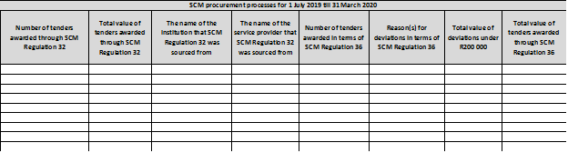
2021/22 MTREF Budget economic and
socio-economic perspective
Presentation examines the extent to which the tabled 2021/22 MTREF Budget is responsive from an economic and socio-economic perspective (consolidation to include entities)
  Enablers of Economic Growth and Development – scm

Slide 104
FMG, Competency Regulation, Budgetary commitment
FMG Plans
> Implementation of competency regulation GAZETTE 41996(Accounting Officer,CFO,4 X Middle Managers,SCM head, Snr. Manager(MSA S56) meet the requirement as such Annexure C is been sent to Treasury bi Annually
Has the municipality identified the number of officials who don’t meet the regulations and what are the plans?
by end of calendar year 2021 non finance managers/official will complete their 15 x MFMP and 15 x PMF respectively
Contracts that have budgetary implications beyond three years (status of the contract entered/or to be entered into)
VAT , assets unbundling , CoreFinancial services , PPE, Revenue enhancementontract
Any challenges and way-forward, some contracts have been on tender and aiming to appoint before end of quarter
Has the Municipality established a Solidarity Fund in response of the President’s Call (NO
Is the Fund establishment and Governance Compliant with the MFMS S12 (NO)

Slide 105
Progress report on Internship programme
Progress report on internship programme
Implementation of internship programme
The municipality has filled the total of 6 x interns as per the regulations and what are the plans if not )
Number of contract extensions all 6 has 1 year extensions until end of June 2021
Names: area of competency:
Ms. Tshikwama Masala B. Com
Ms. Khomba Johanna Business Management(Finance)
Ms. Morwasehla Mokgadi Btech Accounting
Ms. Sidiela Lerato B.Com( Internal Audit)
Ms. Muleya Emelda B.Com
Mr. Ramadwa Shonisani B.Com
Process undertaken to absorb interns.. The intention is to absorb them following financial year and put then in areas they have been occupying for the duration of their rotation
Any challenges and way-forward(financial constrains and the requirement of the transferring agent FMG

Slide 106
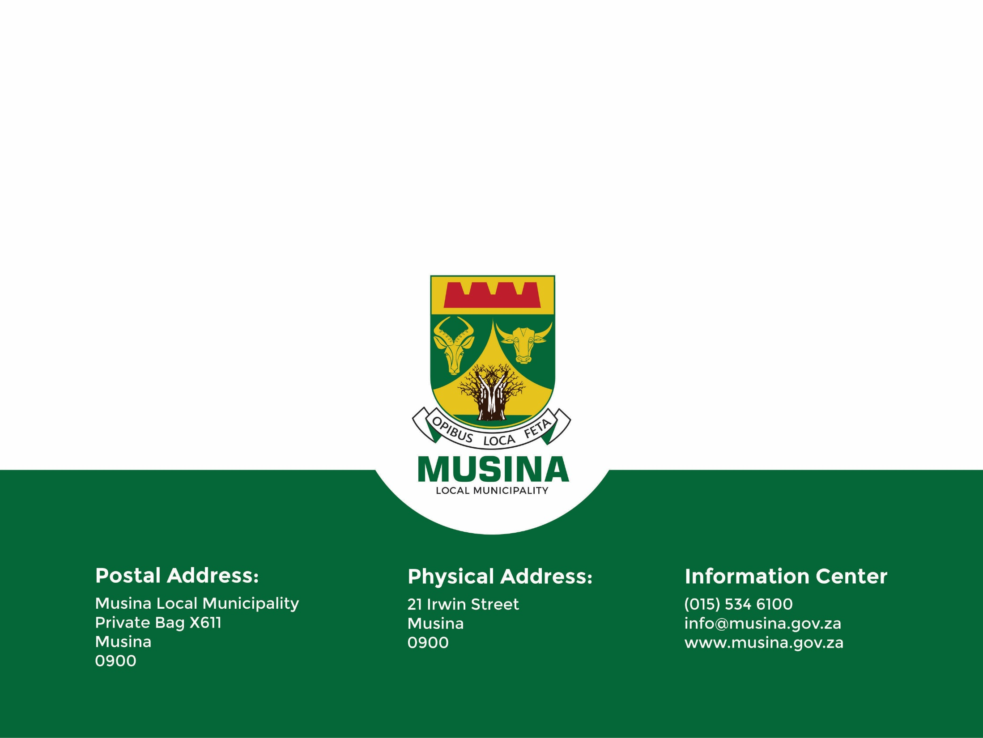
The End
Thank you

